Slide 1
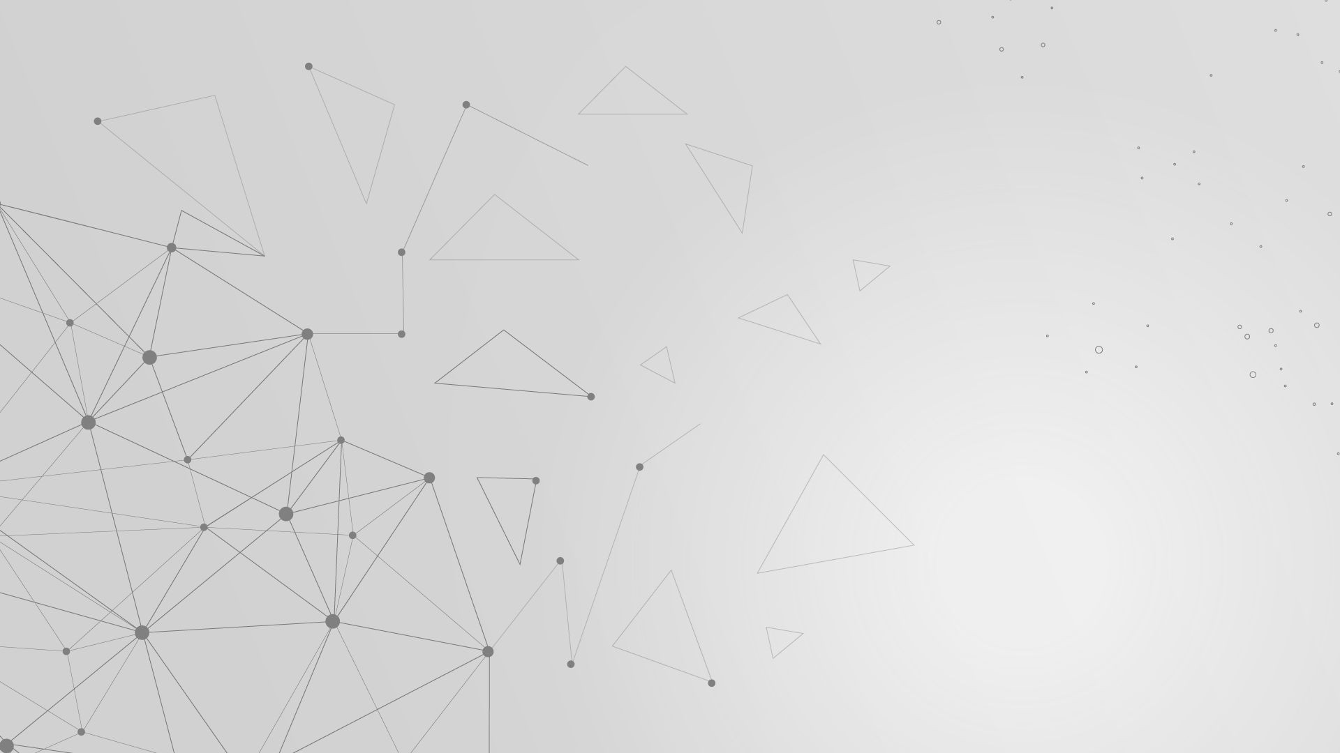
Graph Neural Networks (GNN)

Slide 2
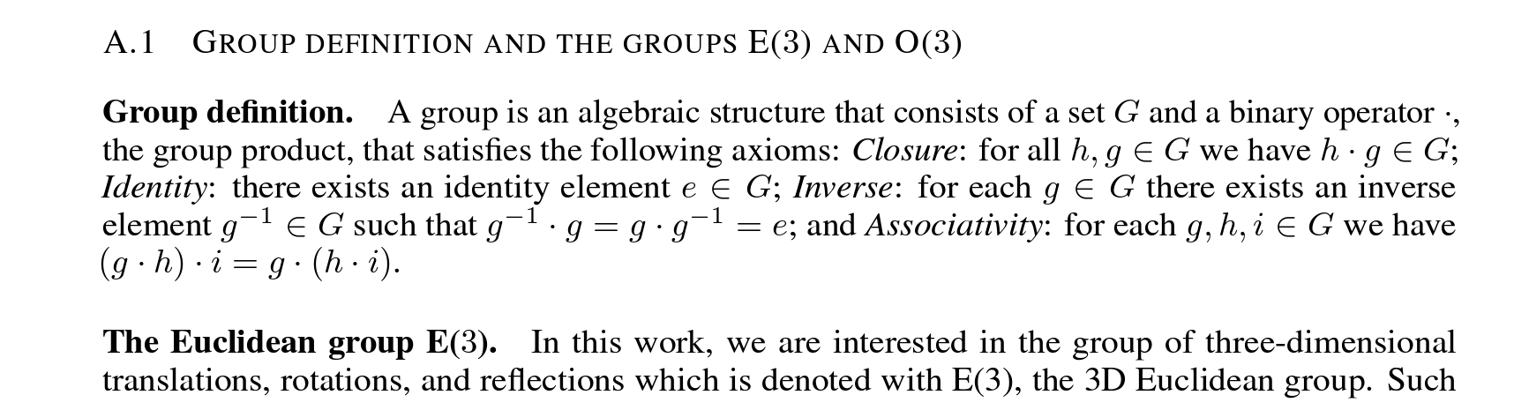
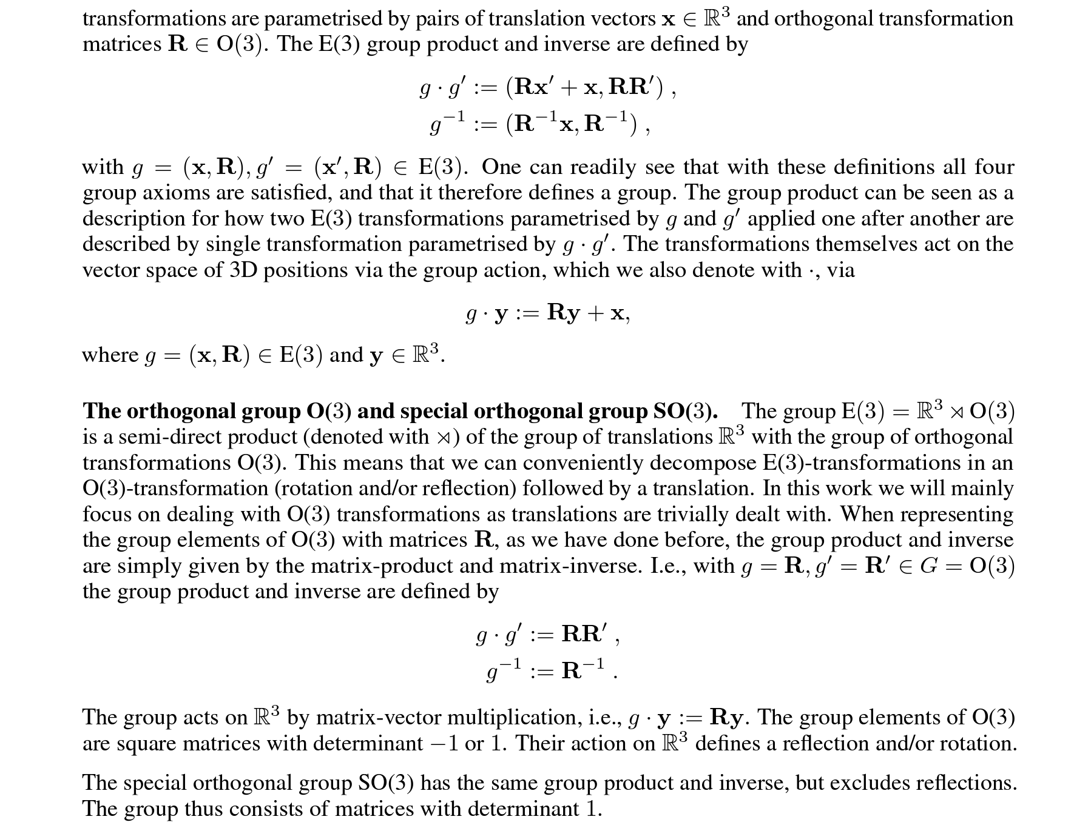
Follow Up from Previous Presentation…

Slide 3
Follow Up from Previous Presentation…

Slide 4
Before we Begin…
Graph Neural Networks (GNNs): GNNs are a type of neural network specifically designed to operate on graph-structured data. In a graph, each node represents an entity, and the edges represent relationships or connections between nodes. GNNs aim to learn node representations by aggregating and passing information between connected nodes in the graph.
Graph Attention Networks (GATs): Graph Attention Networks as a popular variant of GNNs that use the attention mechanism. GATs extend the basic GNN model by incorporating attention coefficients, which determine the importance of neighboring nodes' features for updating a specific node's embedding.

Slide 5
Before we Begin…
Attention Mechanism: In the context of GATs, attention is used to learn the importance or relevance of neighboring nodes' features for a specific node. Attention coefficients act as weights that indicate how much attention or focus should be given to each neighboring node. In GATs, attention allows the network to learn which neighboring nodes are most relevant for updating a specific node's embedding.

Slide 6
Some definition to catch up…
Node Feature Vector: A vector that describes the attributes or properties of a node in a graph.
Adjacency Matrix: A matrix that represents the connections or relationships between nodes in a graph. It indicates which nodes are connected.
Node Embedding: A vector representation that captures the features and information of a node in a graph.

Slide 7
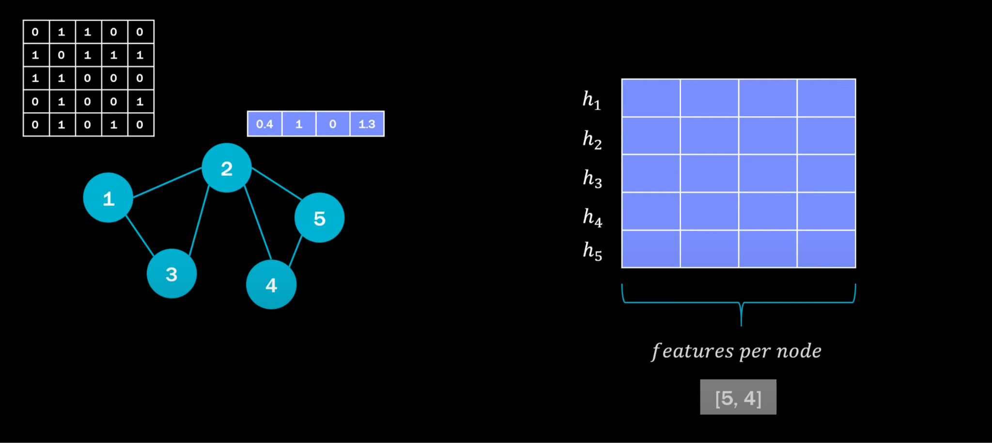
How GNN Works…
Step 1.

Slide 8
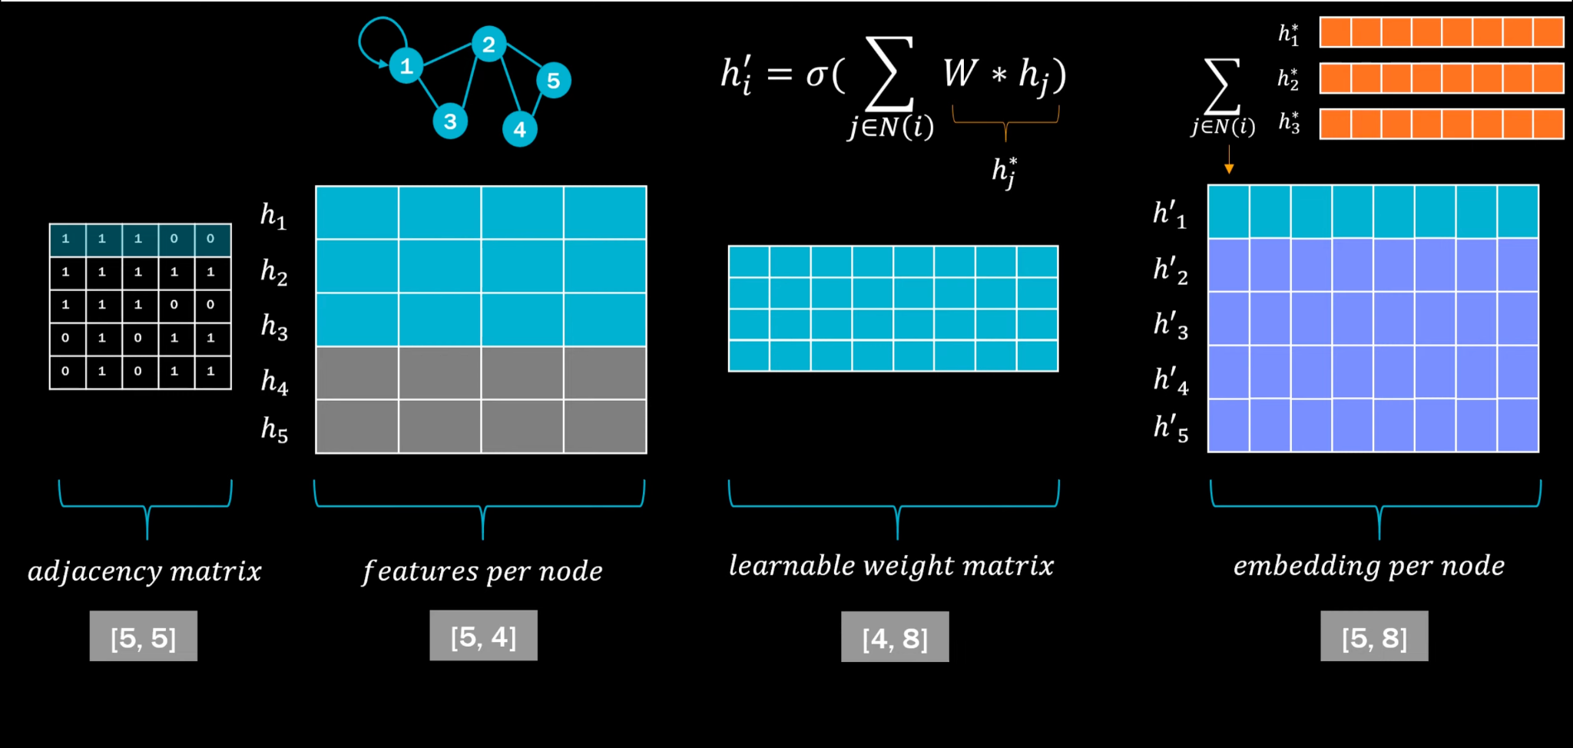
Step 2.

Slide 9
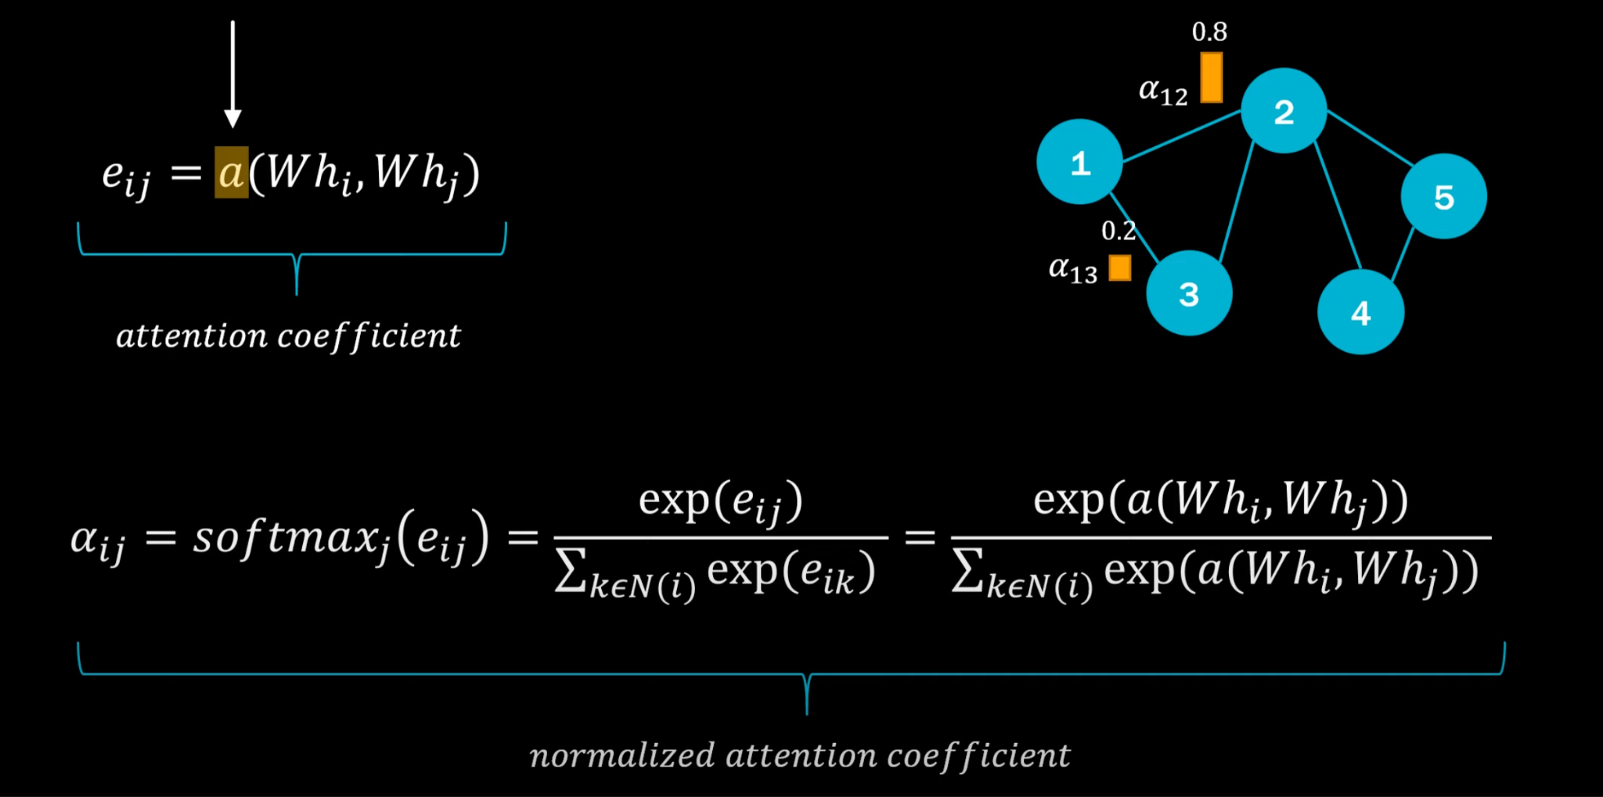
How Attention Comes in Play…

Slide 10
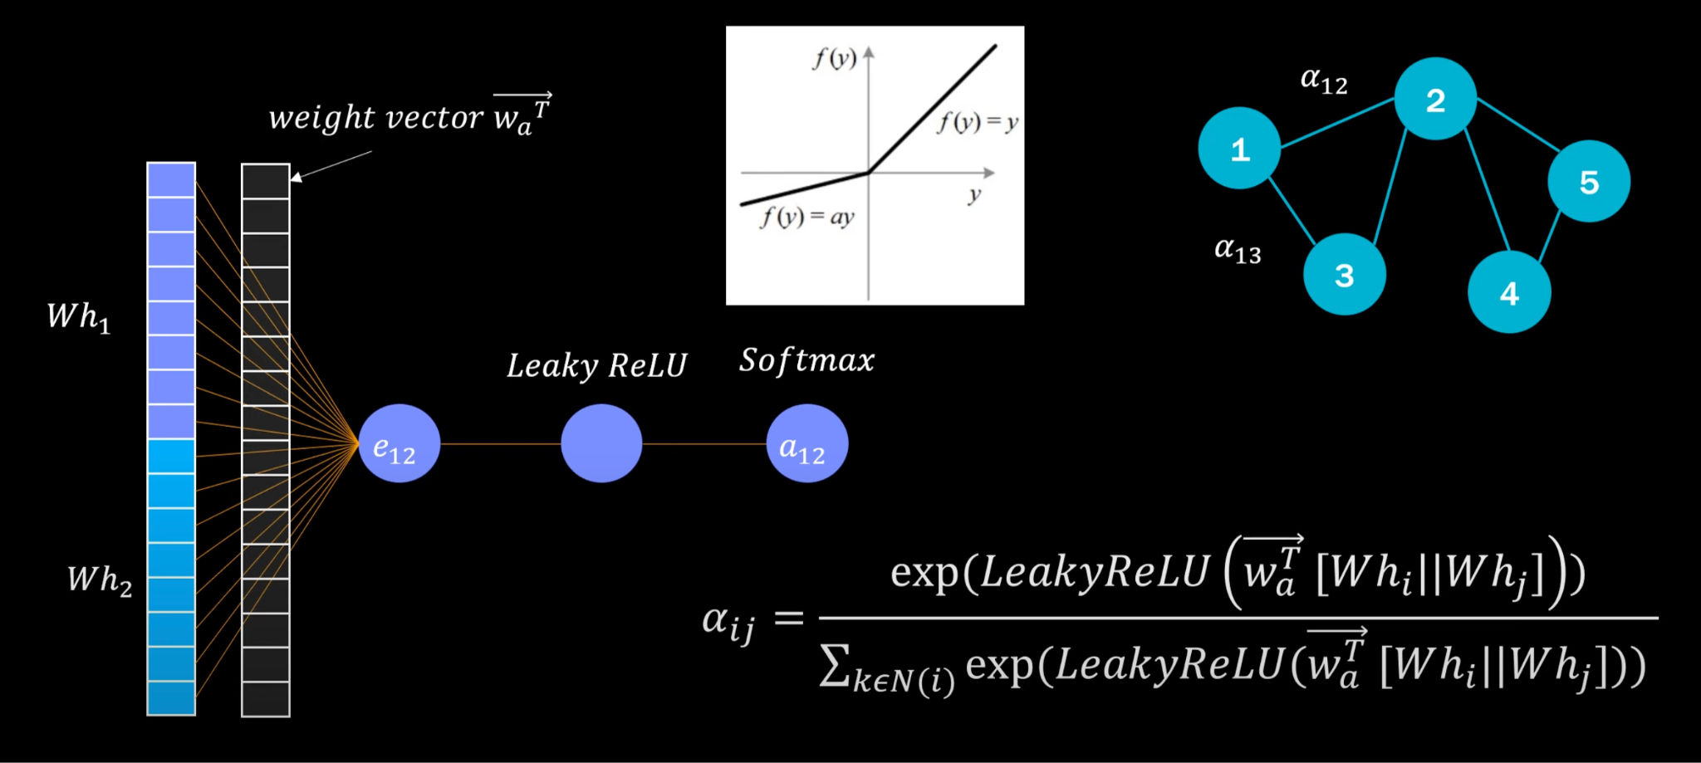
Adding Attention…

Slide 11
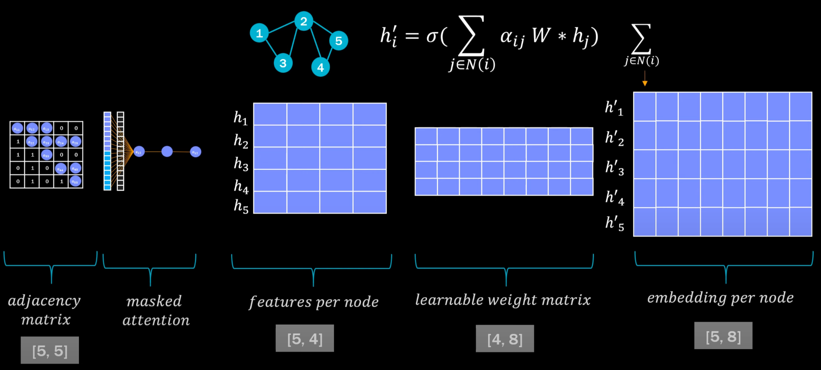
Putting it all together…

Slide 12
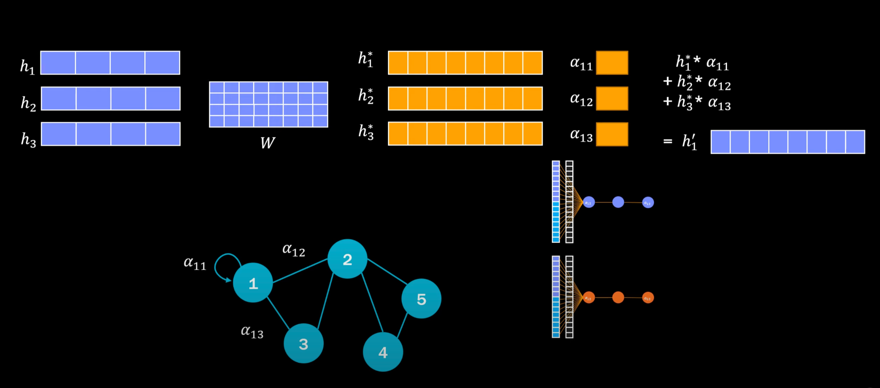
Multi-head Attention…

Slide 13
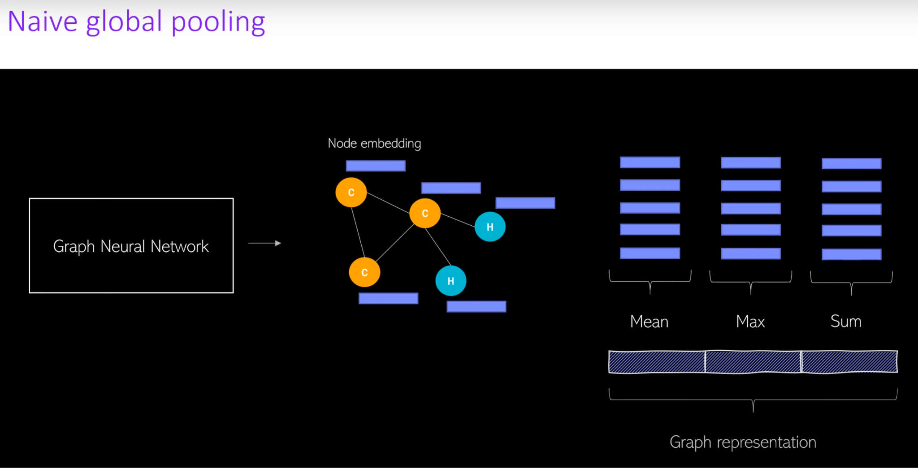

Slide 14
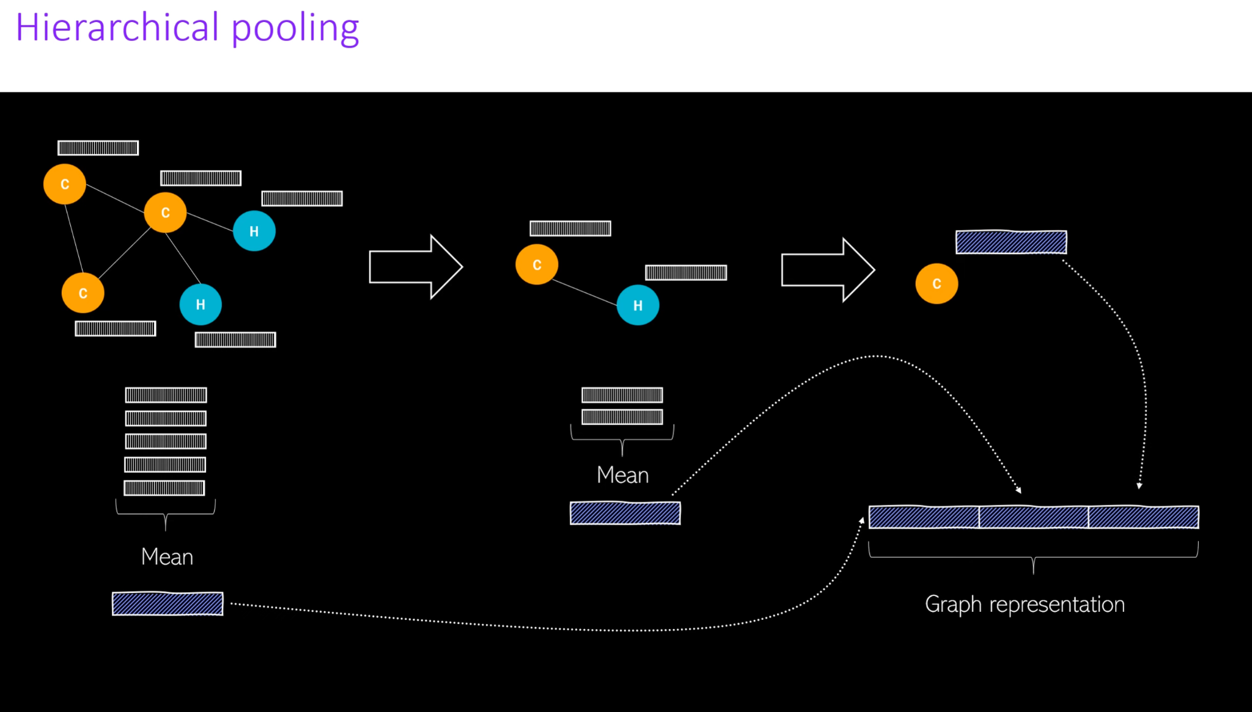

Slide 15
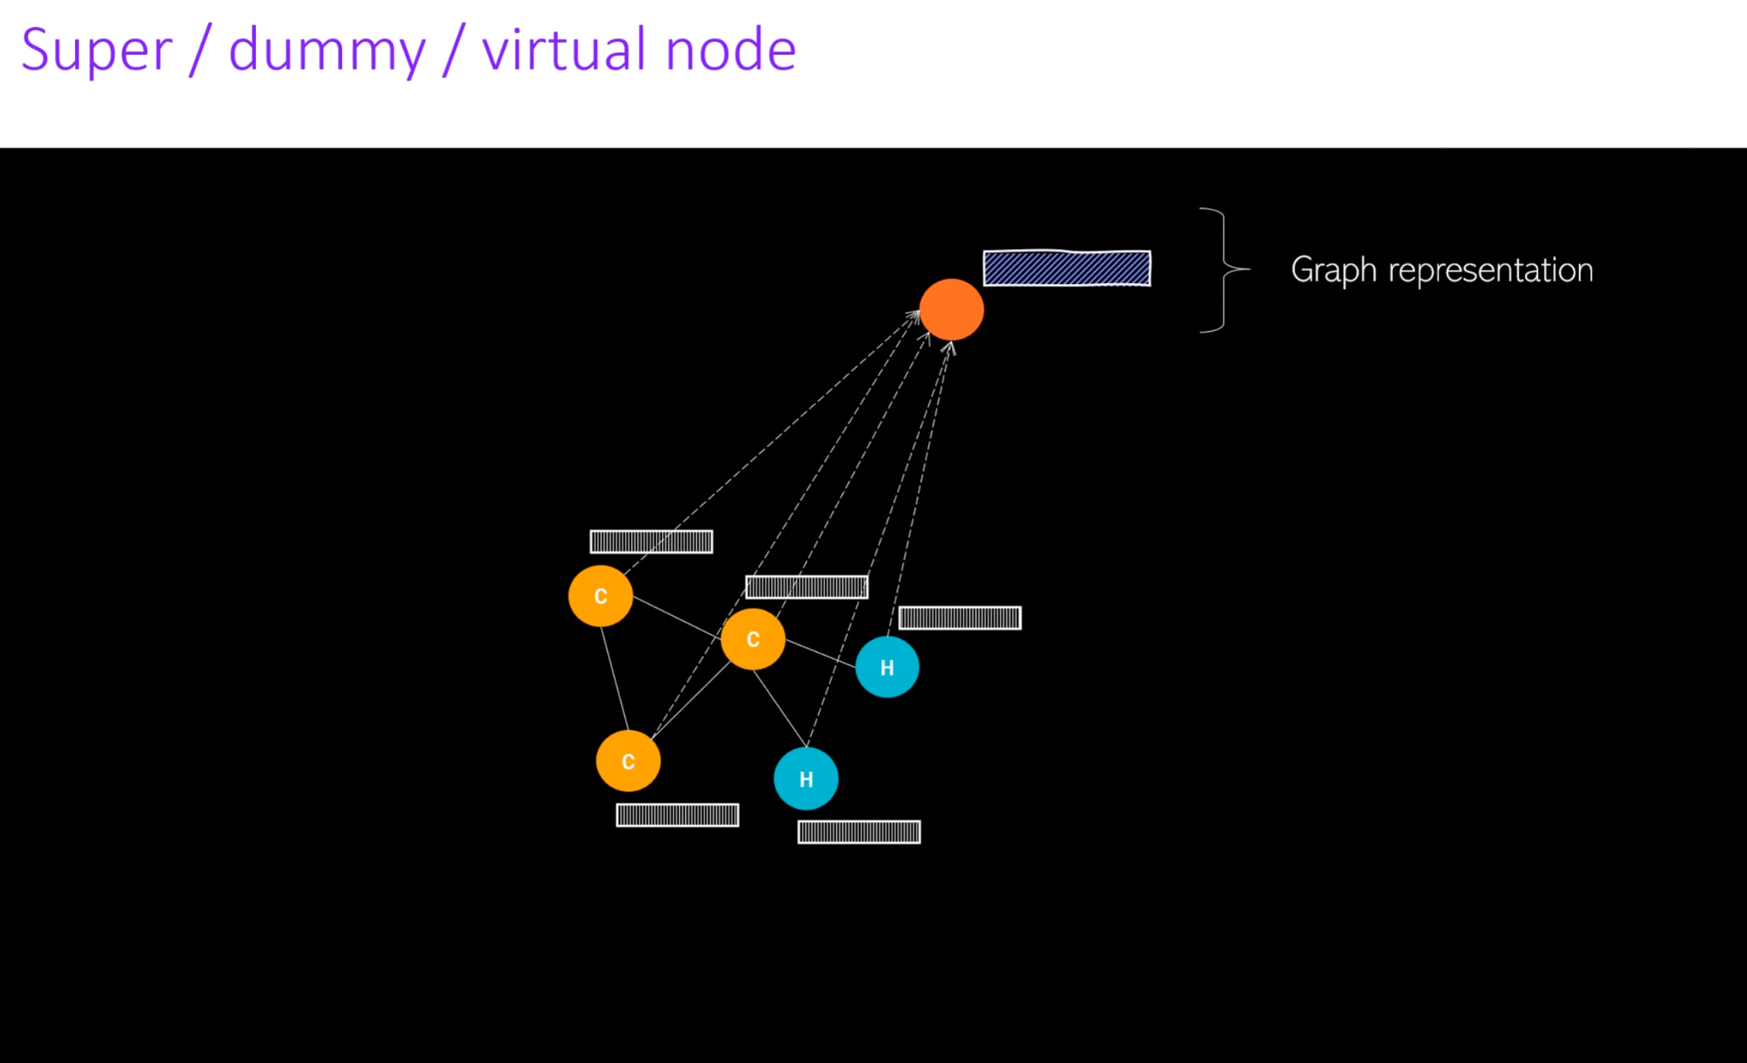

Slide 16
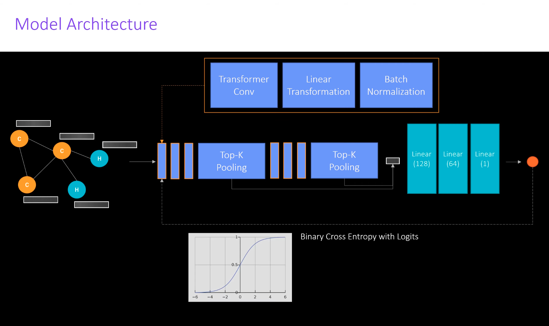

Slide 17
Architecture Overview
The model consists of blocks that contain a graph transformer layer, followed by a linear transformation and batch normalization.
These blocks are stacked several times, and after every couple of layers, top-k pooling is applied to reduce the size of the graph.
The intermediate embeddings after each pooling step are aggregated into a global graph representation.
The number of stacked blocks and the frequency of top-k pooling are hyperparameters in the model.

Slide 18
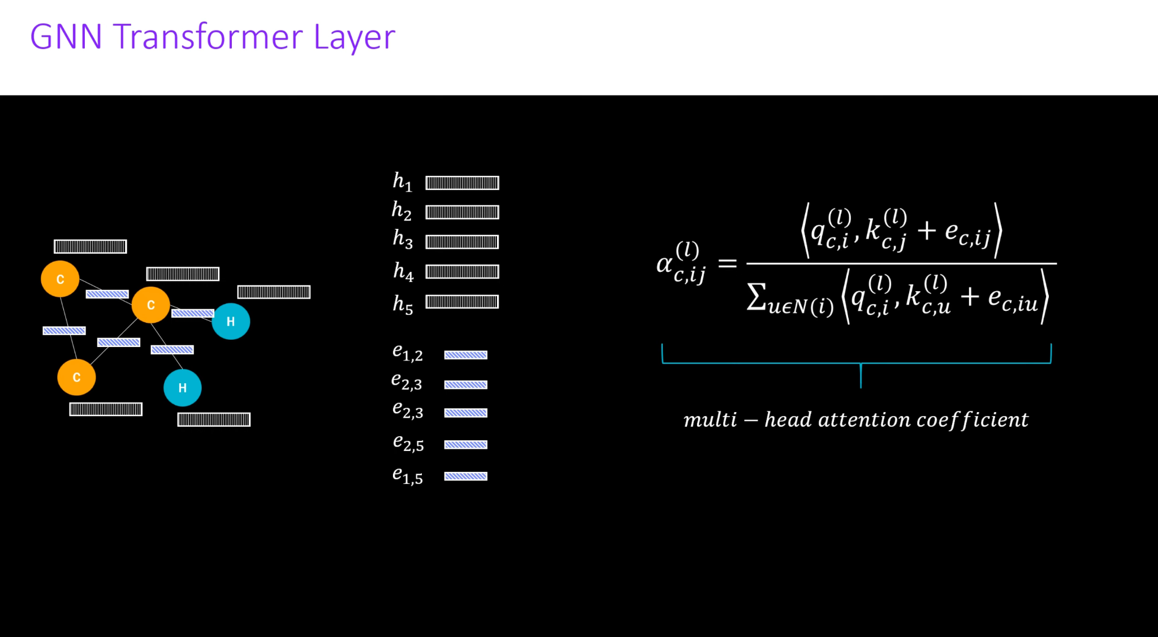

Slide 19
Attention Calculation in GAT
The attention weight alpha between nodes i and j is influenced by the attention head index (c) and the layer index (l).
The attention coefficient determines the importance of node i paying attention to node j when aggregating information.
Queries (q) and keys (k) are obtained by transforming the source and target node features using separate learnable weight matrices.
Edge features (e) between nodes are also multiplied by a learnable weight matrix.
The output of this transformation is q, e, and k.

Slide 20
GAT…
The attention weights are normalized to obtain values between 0-1.
Higher values indicate nodes that should receive more attention during aggregations.
The updated node embeddings are calculated by multiplying each neighbor's transformed node embeddings with the attention weights.
This can be seen as a weighted average of the embeddings, where more important embeddings contribute more to the updated representation.
Edge features are also added during this aggregation.

Slide 21
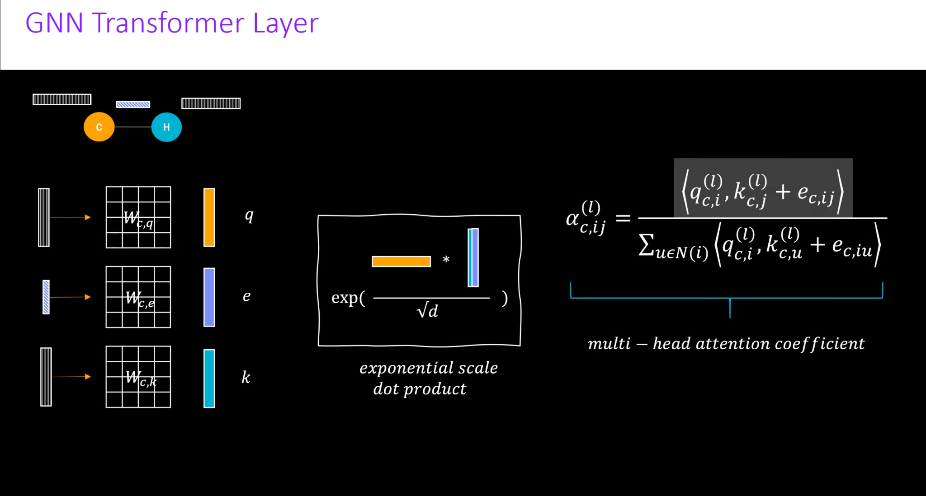
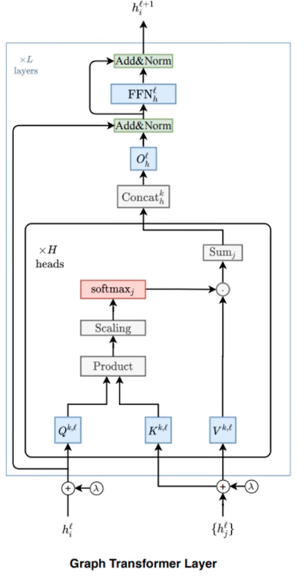

Slide 22
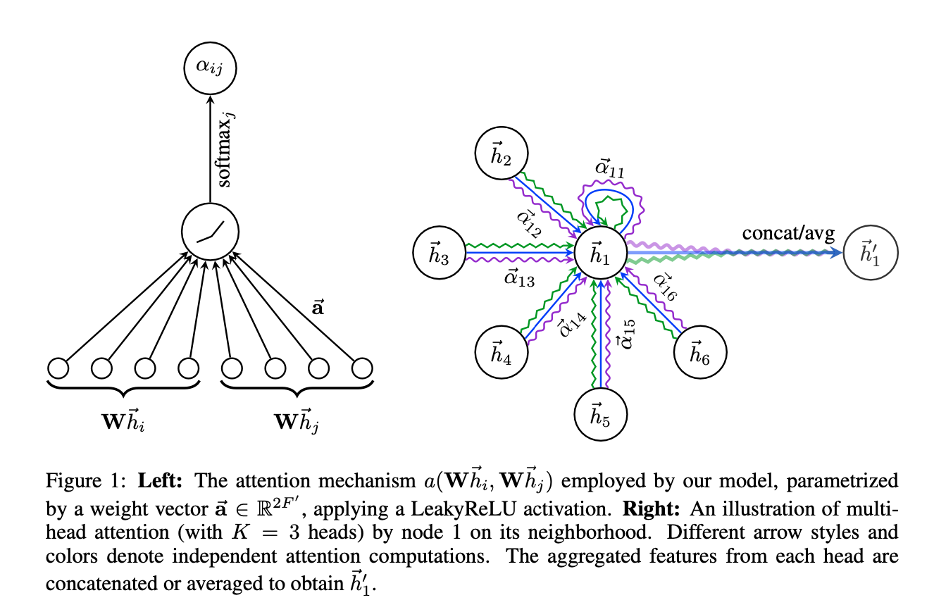

Slide 23
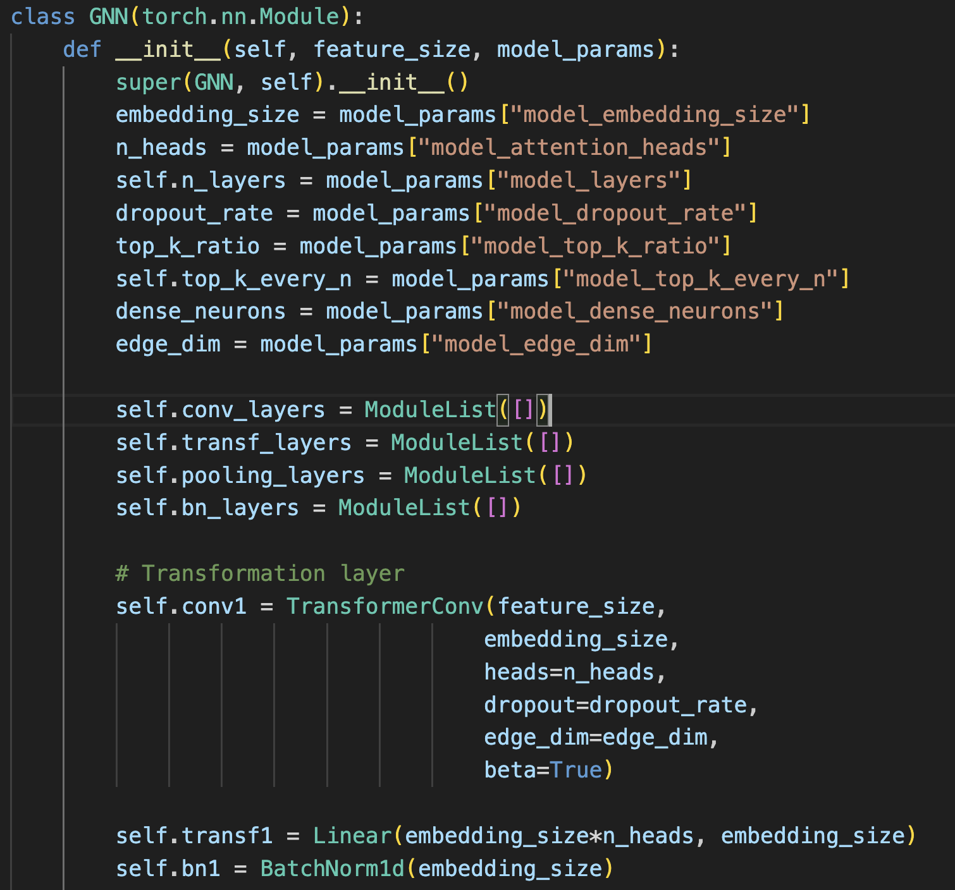

Slide 24
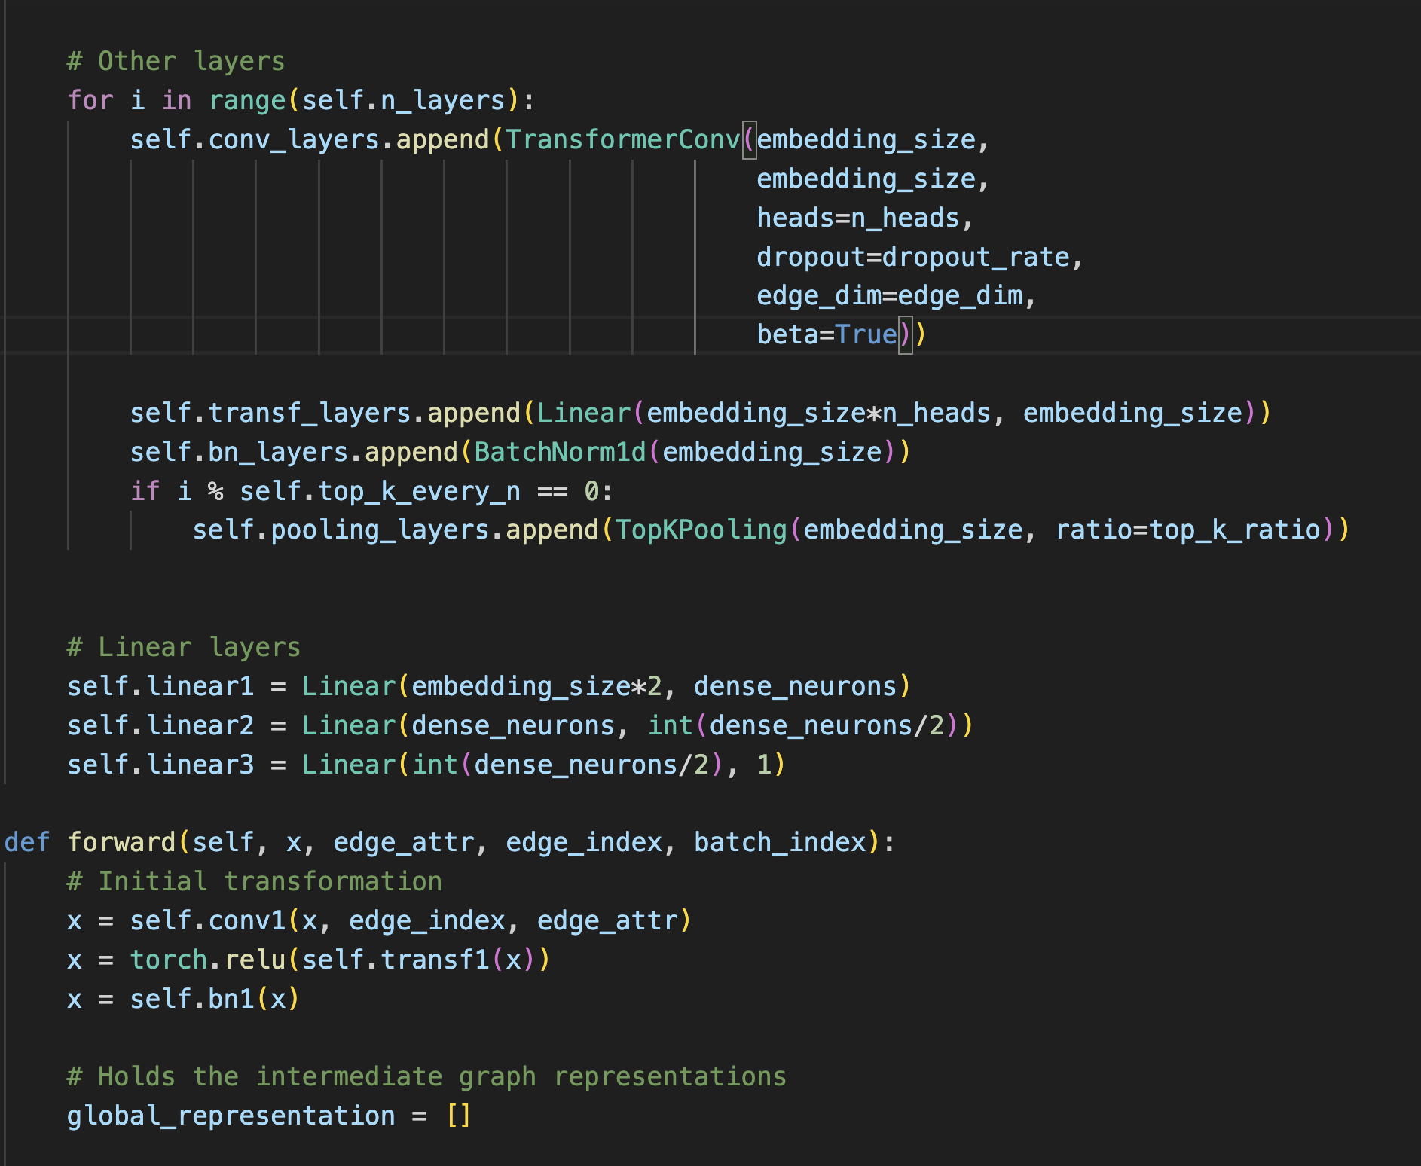

Slide 25
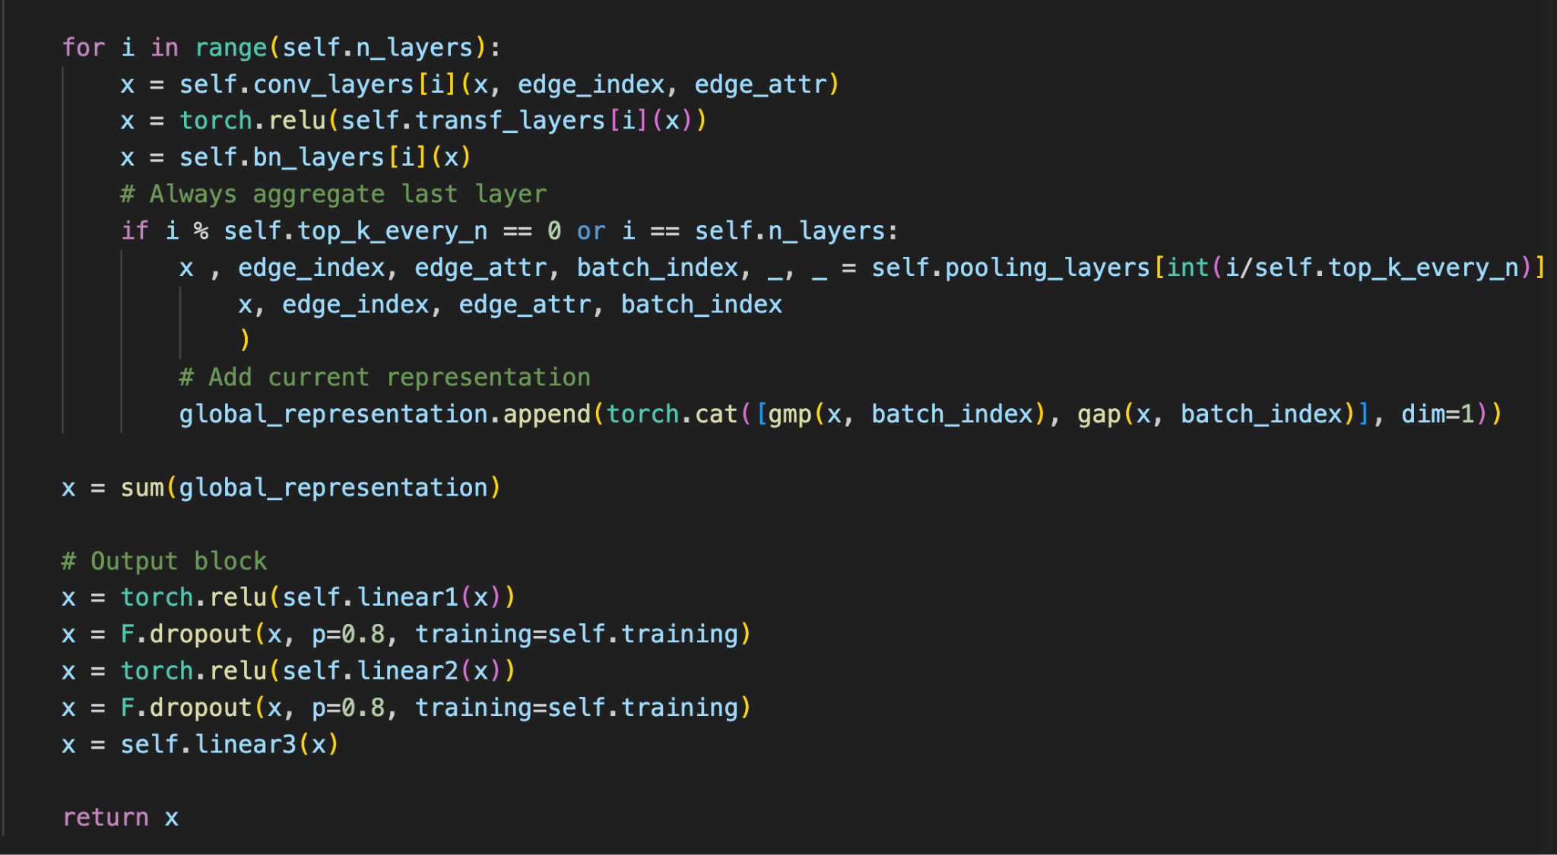

Slide 26
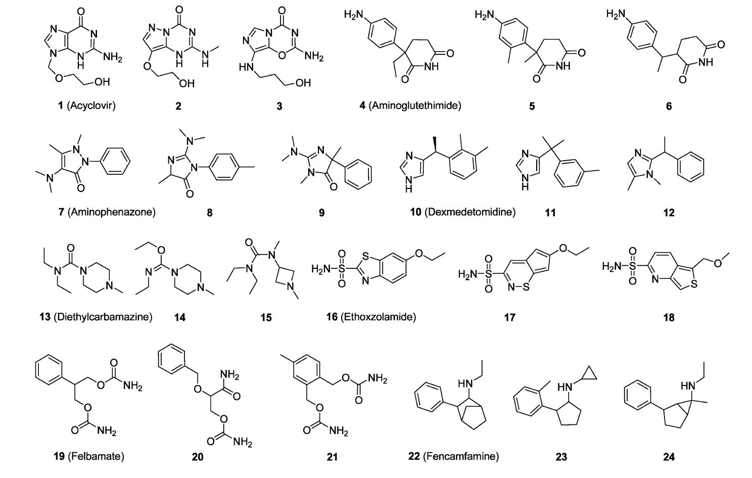
QM9 Dataset

Slide 27
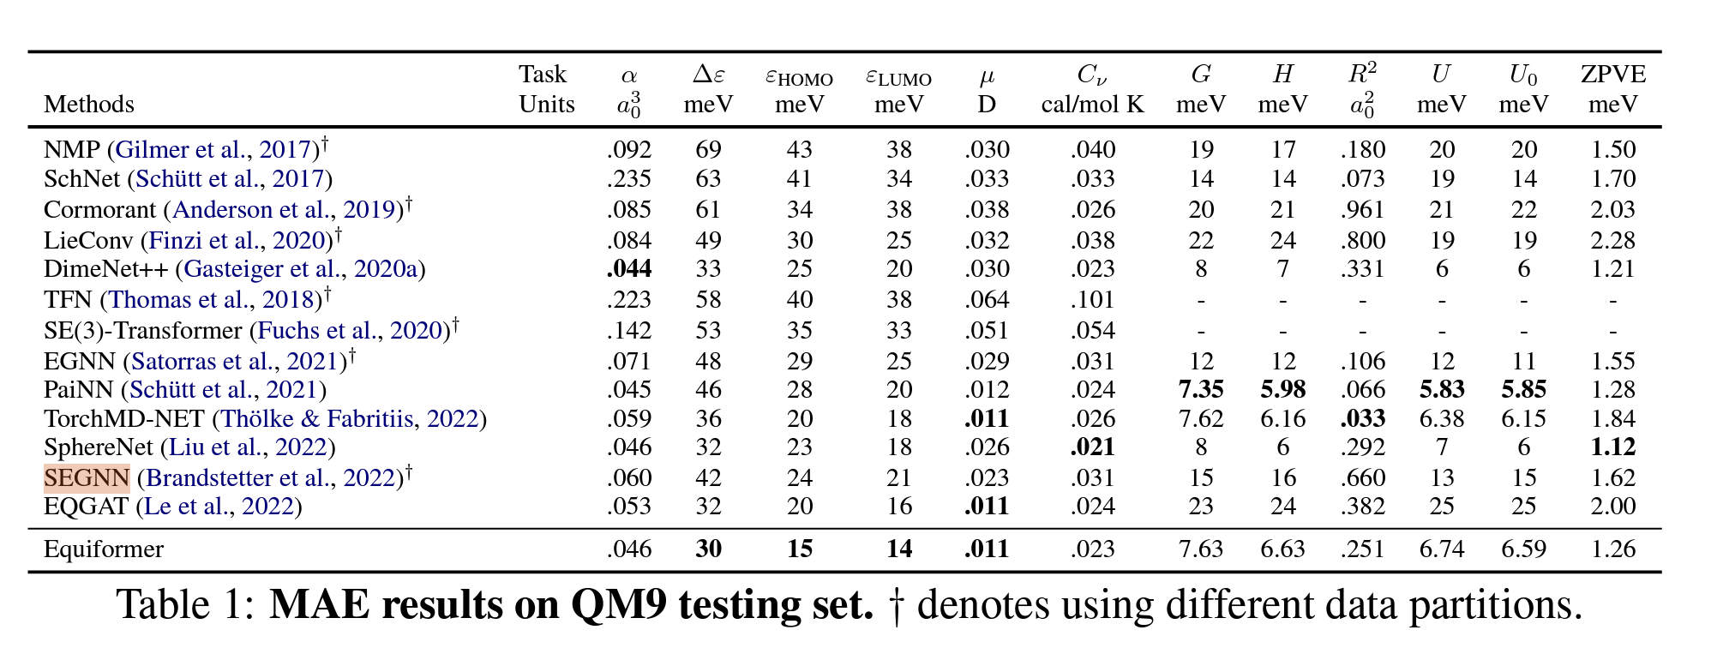
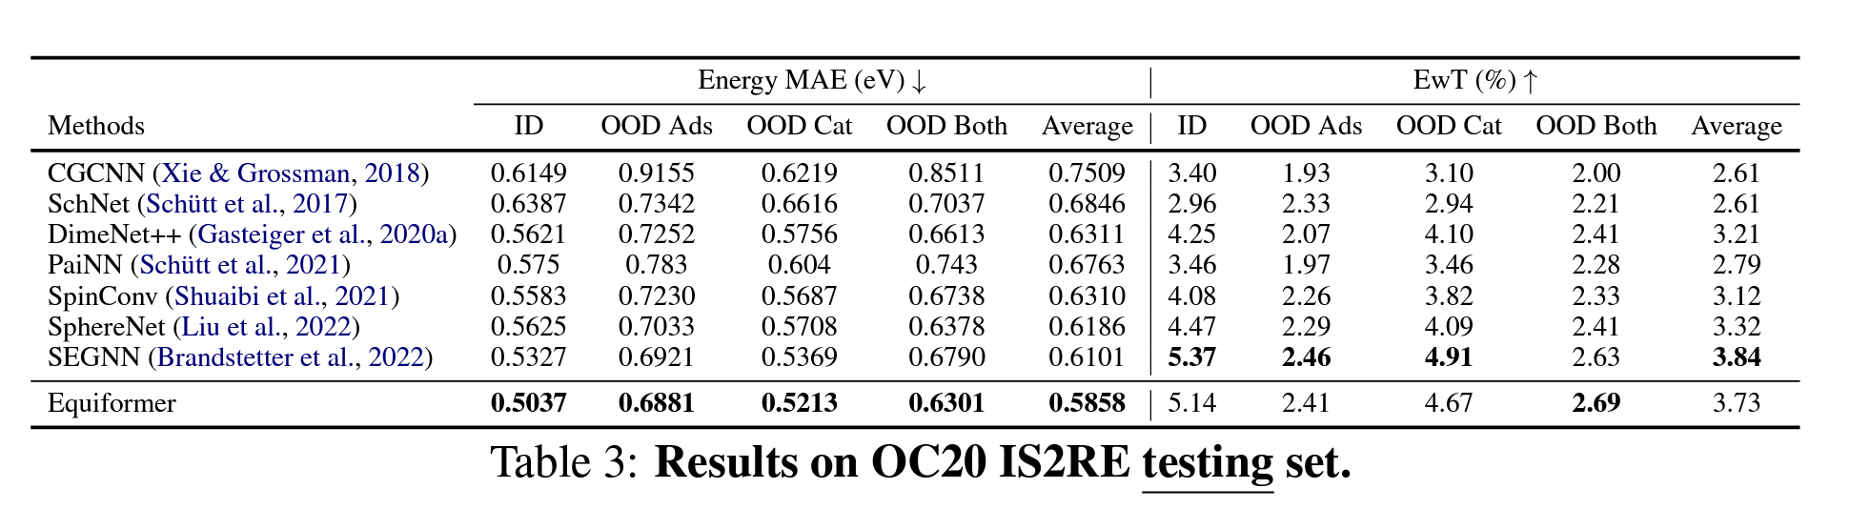
Comparison of Results from various papers

Slide 28
Thank you for your time!

